Slide 1

Templates
Edited by
Dr. Mohammad Nassef
CS-FCI-CU-EG
m.nassef@fci-cu.edu.eg

Slide 2
Function Templates

Slide 3

Function Templates
Function template: a pattern for a function that can work with many data types
When written, parameters are left for the data types
When called, compiler generates code for specific data types determined in function call
Better than Function Overloading:
  You need to create only one version of the function
  Bug fixes will be in one place
  But number of parameters will be fixed.

Slide 4
Function Template Example
template
prefix
  template <class T>
  T times10(T num)
  {
  return 10 * num;
  }
generic
data type
type
parameter
What gets generated when times10 is called with an int: | What gets generated when times10 is called with a double:
int times10(int num) { return 10 * num; } | double times10(double num) { return 10 * num; }

Slide 5
Function Template Example
  template <class T>
  T times10(T num)
  {
  return 10 * num;
  }
Call a template function in the usual manner:
  int ival = 3;
  double dval = 2.55;
  cout << times10(ival); // displays 30
  cout << times10(dval); // displays 25.5

Slide 6
Function Template Notes
Can define a template to use multiple data types:
template<class T1, class T2>
Example:
  template<class T1, class T2> // T1 and T2 will be
  double mpg(T1 Km, T2 gallons) // replaced in the
  { // called function
  return Km / gallons // with the data
  } // types of the
  // arguments

Slide 7
Function Template Notes
Function templates can be overloaded
Each template must have a unique parameter list
  template <class T>
  T sumAll(T num) ...
  template <class T1, class T2>
  T1 sumAll(T1 num1, T2 num2) ...

Slide 8
Function Template Notes
All data types specified in template prefix must be used in template definition
Function calls must pass parameters for all data types specified in the template prefix
Like regular functions, function templates must be defined before being called

Slide 9
Function Template Notes
A function template is a pattern
No actual code is generated until the function named in the template is called
A function template uses no memory
When passing a class object to a function template, ensure that all operators performed by the function template are defined or overloaded in the class definition

Slide 10
Where to Start When Defining Templates

Slide 11
Where to Start When Defining Templates
Templates are often appropriate for multiple functions that perform the same task with different parameter data types
Develop function using usual data types first, then convert to a template:
  add template prefix
  convert data type names in the function to a type parameter (i.e., a T type) in the template
  Remove any redundant versions of the function!

Slide 12
C++11 Templates with a Variable Number of Parameters
Used when it is desired to have the same template work on a variable number of arguments.
For example, summing given values, or finding the max, would normally require writing multiple template function.

Slide 13
add Functions
int add(int value)
{return value;}
int add(int head, int arg1)
{return head + add(arg1);}
int add(int head, int arg1, int arg2)
{return head + add(arg1, arg2);}
int add(int head, int arg1, int arg2, int arg3)
{return head + add(arg1, arg2, arg3);}
int add(int head, int arg1, int arg2, int arg3, int arg4)
{return head + add(arg1, arg2, arg3, arg4);}

Slide 14
add Templates
template <typename T>
T add(T value)
{return value;}
template <typename T>
T add(T head, T arg1)
{return head + add(arg1);}
template <typename T>
T add(T head, T arg1, T arg2)
{return head + add(arg1, arg2);}
template <typename T>
T add(T head, T arg1, T arg2, T arg3)
{return head + add(arg1, arg2, arg3);}
template <typename T>
T add(T head, T arg1, T arg2, T arg3, T arg4)
{return head + add(arg1, arg2, arg3, arg4);}

Slide 15
add Varadic Template
template <typename T>
T add(T value)
{return value;} // 1 value
template <typename T, typename... Ts>
T add(T head, Ts... rest)
{return head + add(rest...);}

Slide 16
add Varadic Template
int main () {
string s1 = "Ali", s2 = " Baba";
cout << add (s1, s2) << endl;
cout << add (1,2,3,4,5) << endl;
cout << add (true, false) << endl;
}

Slide 17
Class Templates

Slide 18
Class Templates
Classes can also be represented by templates.
When a class object is created, type information is supplied to define the type of data members of the class.
Unlike functions, classes are instantiated by supplying the type name (int, double, string, etc.) at object definition

Slide 19
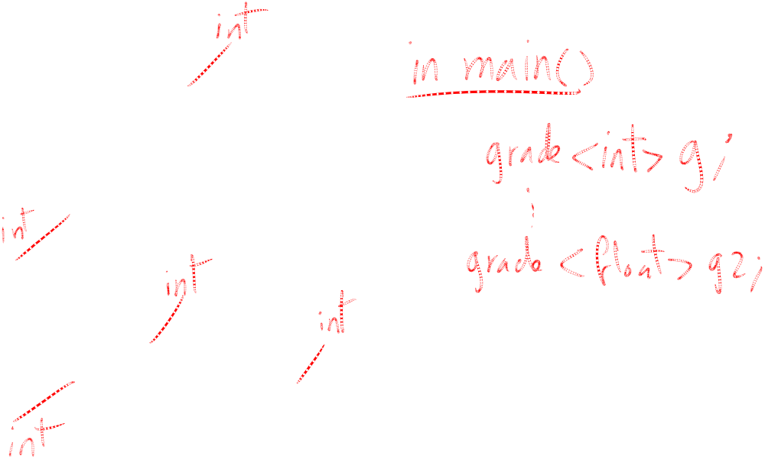
Class Template Example
  template <class T>
  class grade
  {
  private:
  T score;
  public:
  grade(T);
  void setGrade(T);
  T getGrade()
  };

Slide 20
Class Template Example
Pass type information to class template when defining objects:
  grade<int> testList[20];
  grade<double> quizList[20];
Use as ordinary objects once defined

Slide 21
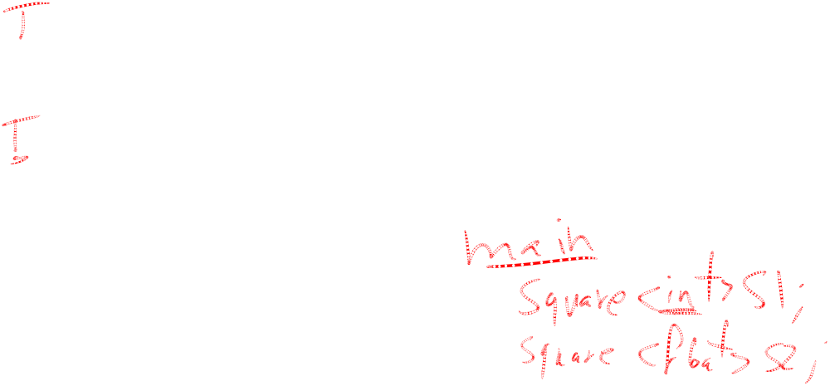
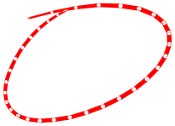
Class Templates and Inheritance
Class templates can inherit from other class templates:
  template <class T>
  class Rectangle
  { ... };
  template <class T>
  class Square : public Rectangle<T>
  { ... };
Must use type parameter T everywhere base class name is used in derived class

Slide 22
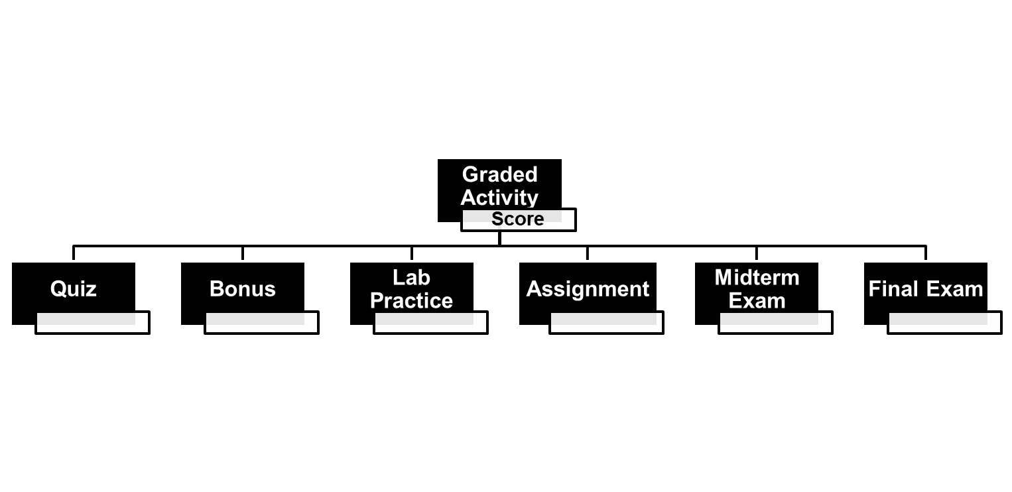
GradedActivity Class

Slide 23
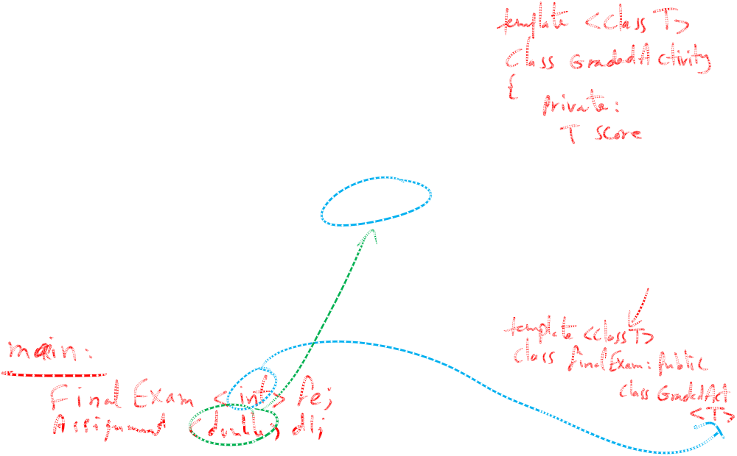
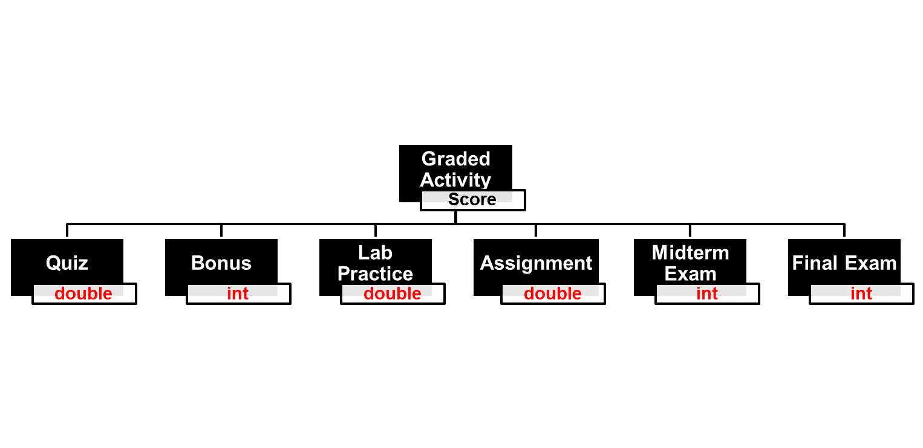
GradedActivity Class

Slide 24
Operator [] and templates

Slide 25
Introduction
If you have a static/dynamic array inside a class, then each object from that class will have its own copy of this internal array.
How can you access (read/write) the elements inside this internal array?
You will need two setter/getter functions that can write/read the value at a specific index!

Slide 26
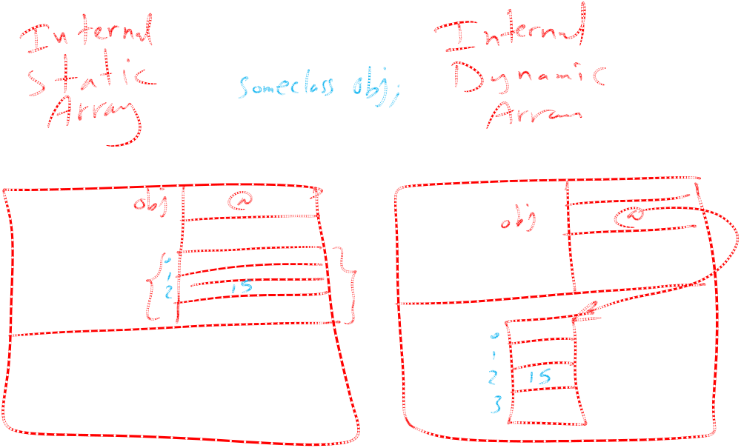

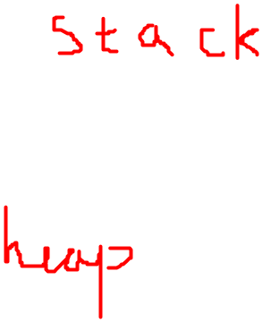
Memory View: Objects with internal Arrays

Slide 27
Overloaded [] Operator
Why?
  Can create classes that behave like arrays,
  Why?
    Need to initialize the array elements
    Can provide boundary-checking on subscripts
    Can perform hidden dynamic re-allocation
    Can use templates to dynamically determine the array data type
Must consider constructor, destructor
Overloaded operator[] returns a reference to object, not a copy of the object.

Slide 28
Try Program YousefVector
How to access the elements of an array inside some object?
On Acadox
Accessing elements of array inside object

Slide 29
template <class T>
class YousefVector{
private:
int size, capacity;
T* data;
public:
YousefVector(int cap = 2);
~YousefVector();
T& operator[](int indx);
void push_back(T item);
int getSize();
T& operator=(const T& other);
};

Slide 30
Overloading and Using Operator []
T& operator[](int indx){
if(indx > size-1 || index < 0) {
cout << "An error has occurred, ";
cout << "index out of range." << endl;
exit(-1);
}
return data[indx];
}
......
YousefVector <string> vec(10);
vec[0] = "Hellooooo";

Slide 31
Passing template objects to functions
If you want to pass an YVector object to a normal function, you must pass a particular instance of the class, not a template.
void SomeFunction(YVector<int>&); // ok
void SomeFunction(YVector<T>&);//error!
void SomeFunction(YVector&); //error!
because there is no class YVector—only the template and the instances.

